Slide 1


Business Analysis Project
Strategies for Combating MagicMade’s Shopping Cart Abandonment
Prepared by Titilayo Balogun

Slide 2




Overview
Business Introduction
Business Problem
Aim of Project
Key Performance Indicators
Insights
Dashboards
Scale of Opportunity
Recommendations

Slide 3

Business Introduction
MagicMade is a growing e-commerce platform that specializes in offering curated digital marketplace experiences for online shoppers. With a strong focus on user experience, convenience, and innovation. MagicMade enables customers to discover, select, and purchase a wide range of products through an intuitive and engaging interface.
The global e-commerce market continues to expand rapidly, with retail e-commerce sales projected to reach over $6.9 trillion by 2025 (Statista, 2024). This growth presents a massive opportunity for platforms like MagicMade to scale revenue, customer base, and brand influence. However, alongside this opportunity comes a major challenge shopping cart abandonment.
As the company scales in an increasingly competitive digital retail landscape, optimizing conversion metrics particularly shopping cart abandonment has become central to its strategy for driving revenue growth and enhancing customer loyalty.
02

Slide 4

Business Problems
Each abandoned cart represents a potential sale that slips through the company's fingers, impacting revenue in a substantial way.
Revenue Impact
High abandonment rates may indicate underlying issues with the shopping experience, from cumbersome checkout processes to unexpected fees, negatively affecting the overall customer experience.
Addressing cart abandonment requires a nuanced understanding of user behavior, enabling targeted marketing strategies to reduce abandonment rates and increase conversions.
Customer Experience
Marketing Optimization

Slide 5
Business Aims
Optimize Marketing Strategies
Enhance Customer Experience
Increase Conversion
Armed with a deeper understanding of customer behaviour, MagicMade seeks to tailor its marketing efforts effectively, reducing cart abandonment, and ultimately increasing sales.
Through data-driven insights, MagicMade intends to identify pain points within the shopping journey and make targeted improvements to create a seamless and satisfying experience for customers.
MagicMade aims to enhance the rate at which customers transition from browsing to making purchases, thereby boosting revenue.

Slide 6


Key Performance Metrics
Cart Performance and Conversion Metrics
Customer Segmentation and Behavioural Patterns.
Device and Technical Experience
Marketing Attribution and Referral Insight

Slide 7
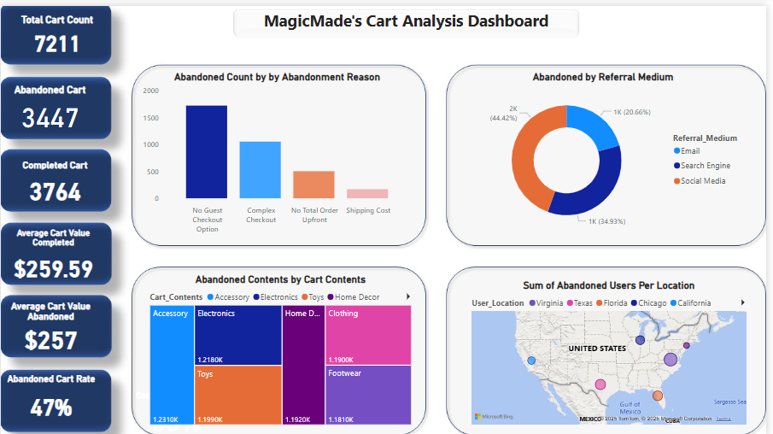

Slide 8
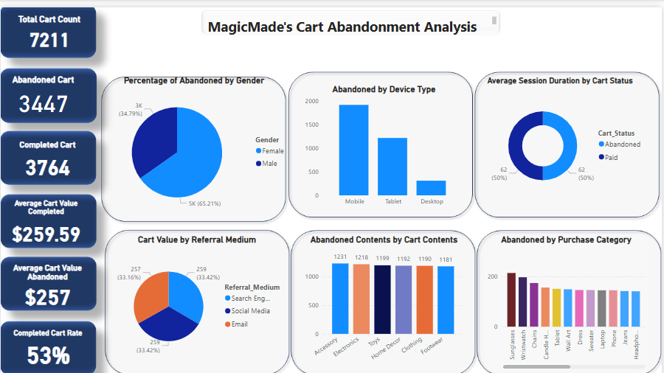

Slide 9
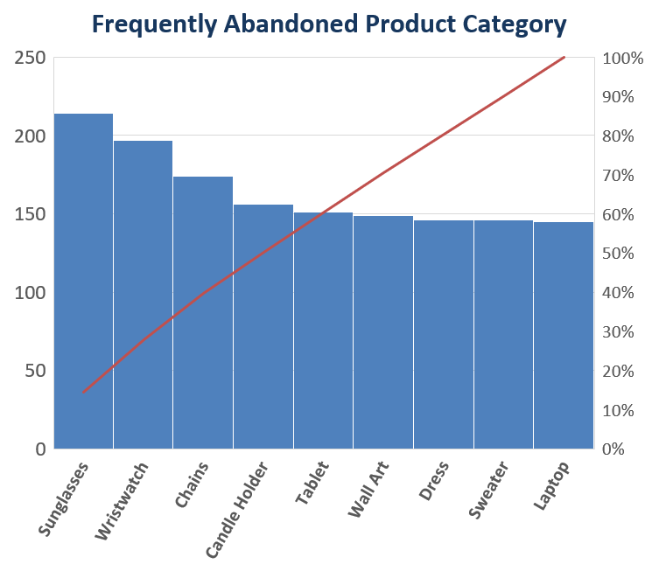
Findings
A. Cart Performance and Conversion Metrics

Slide 10
Findings
B. Customer Segmentation and Behavioural Pattern

Slide 11
Findings
C. Device and Technical Experience Analysis

Slide 12
Findings
D. Marketing Attribution and Referral Insights

Slide 13

Insights
Cart Performance and Conversion Metrics
A 47% abandonment rate, while better than the industry average of ~69%, still represents a significant opportunity for improvement. Roughly 1 in 2 customers are not completing their purchase, which directly impacts revenue.
Minimal difference in average cart value of abandoned ($259.59) vs completed ($257.03) implies that price alone isn’t the primary deterrent other experiential or technical issues are likely at play.
High-value carts are being lost at a substantial rate. These carts represent a high-revenue opportunity segment.
Frequently abandoned product category such as sunglasses, wristwatches, chairs may indicate higher price sensitivity, comparison shopping behaviour, or unclear product information.
Frequently abandoned cart contents such as accessories, electronics, toys may suffer from perceived value concerns or low differentiation.

Slide 14

Insights
Customer Segmentation and Behavioural Pattern
There is no significant gender-based skew. Cart abandonment is widespread and not driven by demographic preference.
Equal session time suggests that users are engaging deeply regardless of outcome, but something in the final stage is breaking the conversion.
Behaviour shows that users are willing to spend time, but friction or dissatisfaction is likely occurring later in the process.

Slide 15

Insights
Device and Technical Experience Analysis
Mobile (48%), tablet (47%), desktop (46%), slightly higher abandonment on mobile is consistent with industry patterns where mobile UX issues are common.
No Guest Checkout (50%), Complex Checkout (30%), No Total Order Upfront (15%), Shipping Costs (5%) signifies a major friction points are within the checkout flow, not product discovery. Guest checkout is a critical barrier.

Slide 16
Insights
Marketing Attribution and Referral Insights
Social media leads to the most abandonment. This may point to unqualified or browsing-driven traffic from social platforms.
Value range ~$257–$259 is stable across all referral channels, meaning that the issue isn’t with customer value but conversion execution.
High abandonment in the locations Virginia, Texas, Florida, Chicago, California, New York (Descending Order) may reflect regional behavioural patterns, local promotions, or shipping speed concerns.

Slide 17
Scale of Opportunity for E-commerce
Global e-commerce sales projected to reach $6.9 trillion by 2025 (Statista, 2024).
Cart abandonment rates average 68–75% across the industry (Baymard Institute).
Mobile users experience the highest abandonment rates due to poor UX.
Abandonment = lost revenue & poor customer experience.
Even a 10–20% reduction in abandonment can yield significant revenue gains

Slide 18
Recommendations
Enable guest checkout to eliminate registration barriers, especially for new or impulse buyers. This could reduce abandonment by up to 30–50%, directly increasing conversion rate and revenue by converting high-intent visitors.
Simplify mobile and tablet checkout by using auto-fill, one-page checkout, and progress indicators. Improving checkout UX can lift mobile conversions by 15–20%, driving growth among mobile-first users and create a seamless and satisfying customer journey.
Show estimated total cost including taxes and shipping early in the process or on the product page. This will reduce late-stage surprises, helping users make informed decisions, improving user trust and lowering abandonment.
Offer free shipping for carts over $200 to incentivize completion of high-value purchases. This will motivate high-intent buyers to complete transactions, recovering potential thousands in lost revenue and boosting AOV (Average Order Value).
Deploy automated email or SMS cart reminders with personalized content, urgency messaging (e.g., “Items going fast”), and incentives (discounts or free shipping). Industry standards show 15–25% of abandoned carts can be recovered, leading to immediate revenue uplift.

Slide 19
Recommendations
Refine ad targeting, enhance landing page experience, and align messaging from ad to product page for better intent match. This could turn a large share of traffic into actual buyers, improving marketing efficiency and cost-per-acquisition (CPA).
Improve product descriptions, add high-quality images, customer reviews, and limited-time deals on these items. This will enhance user confidence and urgency, increasing conversion on products with high interest but low completion.
Use geo-segmented and device-specific retargeting ads and content to re-engage users with personalized offers or localized messages. More relevant messaging increases response rate, improving re-engagement and conversions in underperforming regions.
Deploy funnel analysis, heatmaps, and session recordings to pinpoint where users disengage. Pinpointing micro-frictions allows for surgical improvements, increasing conversion without major redesigns.
Develop predictive customer segments using AI/ML or rules (e.g., cart value > $200 + mobile + from Texas = high risk of abandonment). Trigger proactive nudges such as a chatbot or discount popup. Early intervention leads to reduction in drop-off and enhanced user satisfaction.

Slide 20



Thank You
Titilayo Balogun
ebalogun47@gmail.com

